Slide 1
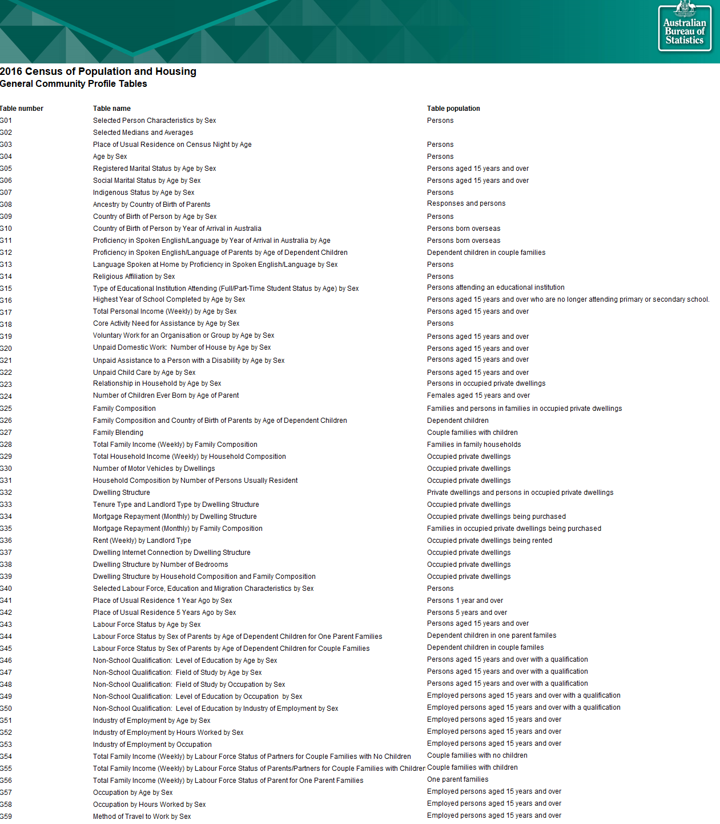
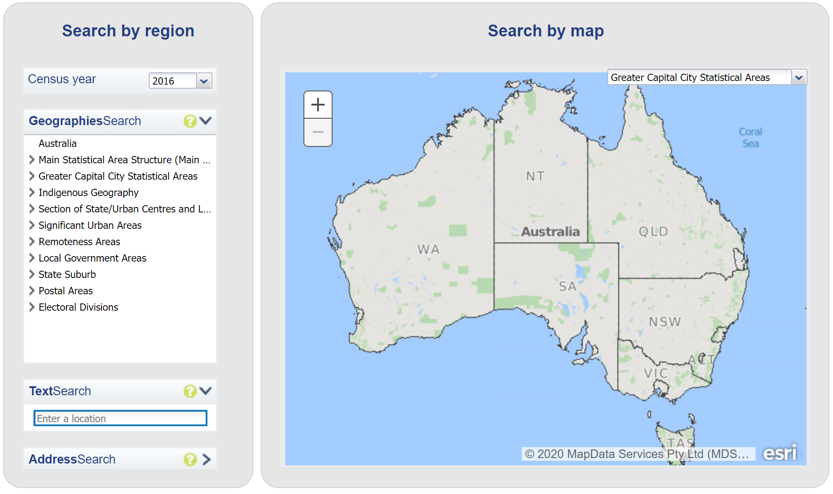
The Problem (Solving with Data)
1
2
3
https://www.abs.gov.au/websitedbs/D3310114.nsf/Home/2016%20search%20by%20geography
https://www.abs.gov.au/AUSSTATS/abs@.nsf/DetailsPage/1270.0.55.001July%202016
https://www.abs.gov.au/AUSSTATS/abs@.nsf/DetailsPage/1410.02014-19?OpenDocument
Notes:
Planned duration for this slide: 0:45.

Slide 2
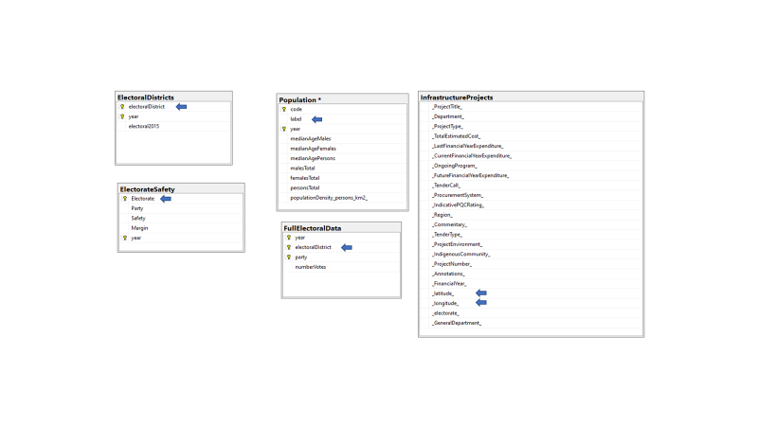
The Problem (Solving with Data)
Notes:
Planned duration for this slide: 0:45.

